Slide 1

Hotel Aggregator Analysis using Power BI
By Swapnil Vicky

Slide 2
TABLE OF CONTENTS
01
02
03
04
05
06
Geographical Insights
Pricing & Availability
Host Performance
Review Scores & Guest Satisfaction
Property & Room Type Analysis
Recommendations

Slide 3
Problem Statement
This internship project aims to analyse a dataset of hotel aggregator listings using Power BI. The dataset comprises various attributes related to listings, hosts, reviews, and availability. The objective is to create comprehensive visualizations and insights that shed light on trends, patterns, and factors influencing the performance of listings. Through Power BI, interns will explore key metrics such as pricing, availability, host characteristics, and review scores to derive actionable insights for improving the overall quality and competitiveness of the listings.

Slide 4
Outcomes
* Interactive Power BI dashboards illustrating geographical distribution, pricing trends, host characteristics, and review scores. * Reports on availability patterns, property and room preferences, and factors influencing guest satisfaction. * Recommendations for hosts and the aggregator platform based on the analysis.

Slide 5
00
Import data into Power BI and clean up using Power Query Editor

Slide 6
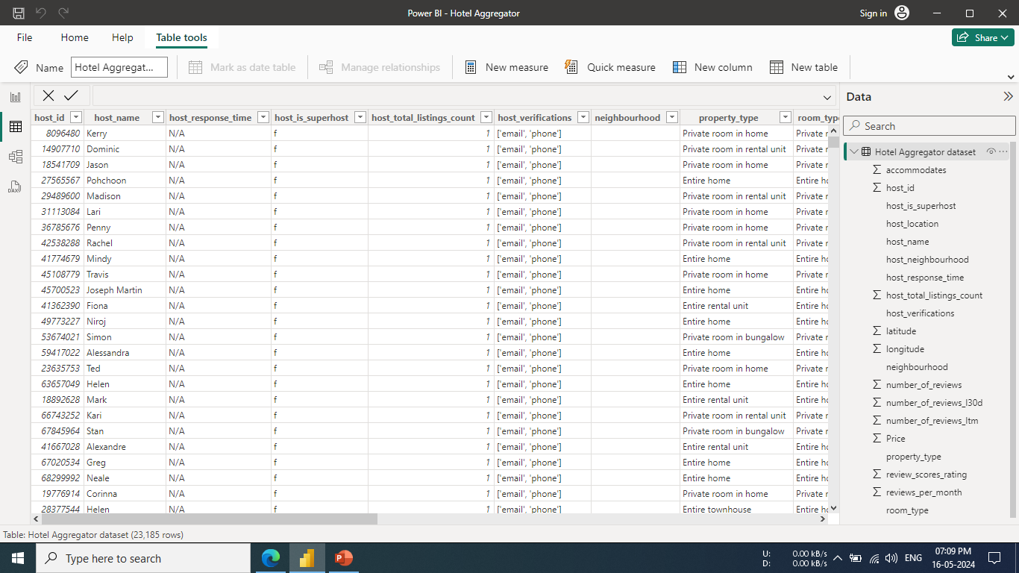

Slide 7
01
Geographical Insights

Slide 8
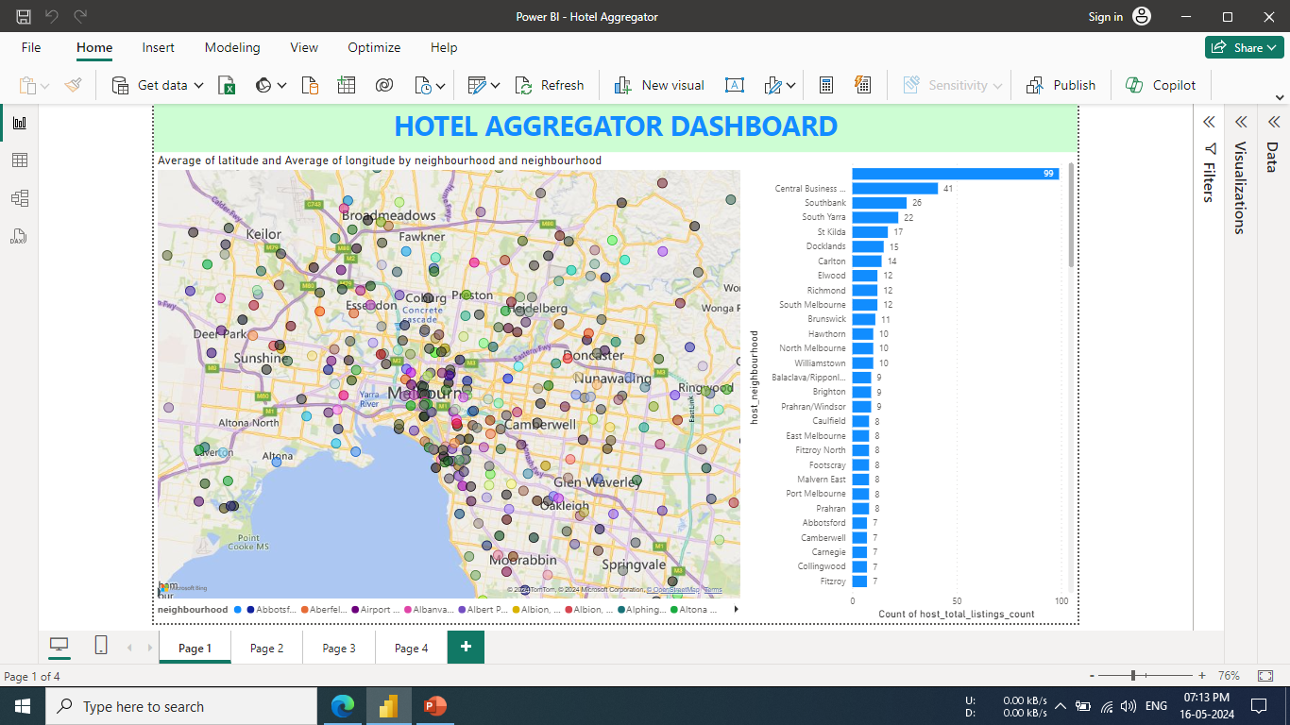

Slide 9
02
Pricing and Availability Dashboard

Slide 10
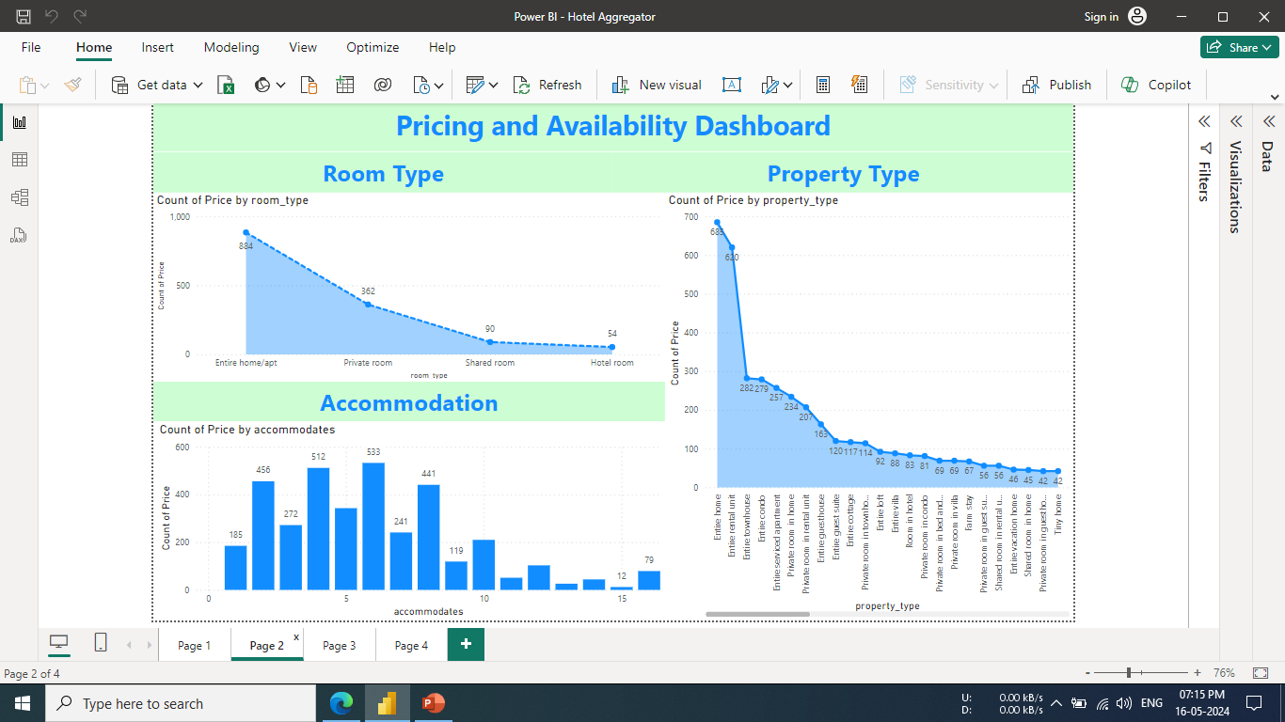

Slide 11
03
Host Performance Dashboard

Slide 12
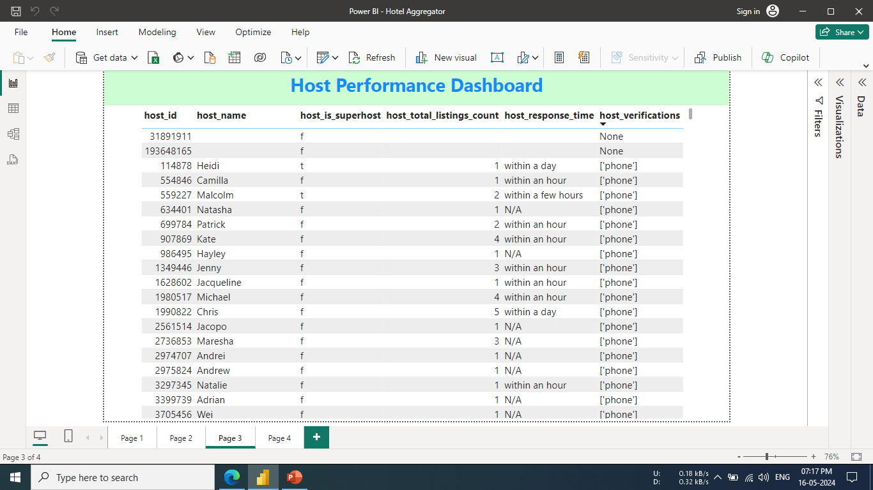

Slide 13
04 & 05
Review Scores and Guest Satisfaction Insights

Slide 14
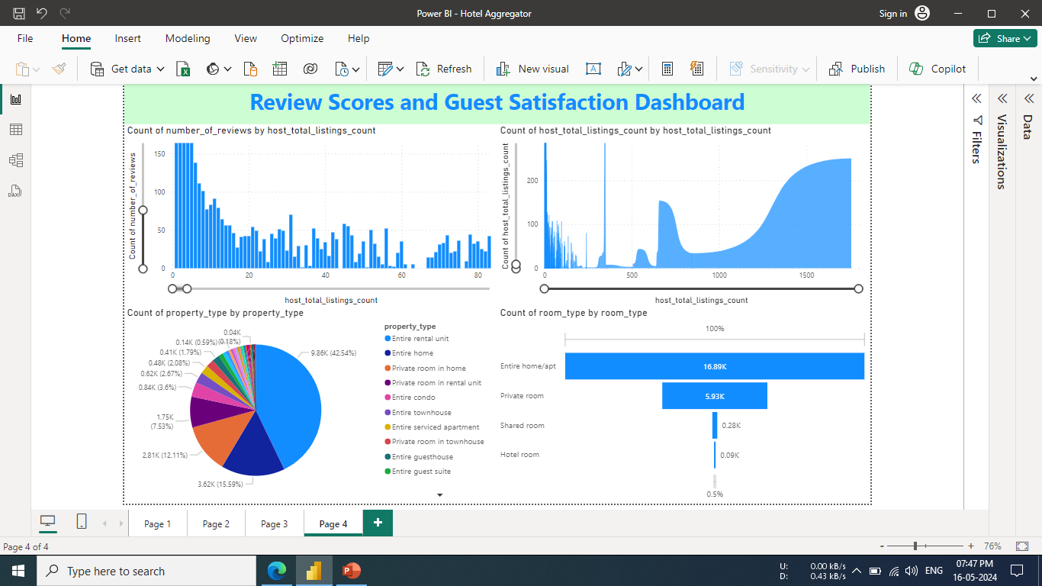

Slide 15
06 Recommendations
Ensuing that guest’s expectations match their experienes can lead to higher review scores and more bookings on the go.
Optimizing availability based on demand can help maximize bookings and revenue.
Consider the lowest review ratings in communication and locations, then the factors behind this low ratings, improve communication as one low rating can highly affect other ratings like location.
High availability on certain dates, could indicate high demand. Increasing prices on these dates to maximize revenue could be a good strategy.
Consider seasonality in pricing and availability strategy. Prices might be higher during peak tourist seasons and lower during off-peak times.

Slide 16

THANK YOU

